Slide 1
Java 8 Functional Interfaces
momedaram

Slide 2
Functional Interfaces:
Functional interfaces are the interfaces which has exactly one abstract method.
They may have any number of default methods but must have only one abstract method.
Functional interfaces exist before Java8:
Runnable , ActionListener, Callable, Comparator
Java 8 Functional interfaces :
Predicate
Consumer
Function
Supplier
BiPredicate
BiConsumer
BiFunction
UnaryOperator
BinaryOperator
java.util.function package

Slide 3
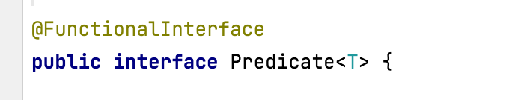
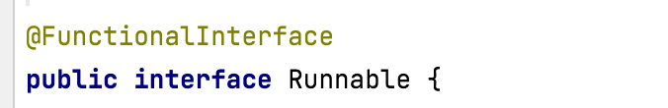
@FunctionalInterface :
@FunctionalInterface annotation is used to represent functional interfaces.
It is not compulsory to write functional interface using this annotation.
But if we are using @FunctionalInterface annotation then interface should contain only one abstract method. If we try to write more than one abstract method, compiler will show the error.

Slide 4
Predicate<T>:
Represents a predicate (boolean-valued function) of one argument.
boolean test(T t);
Evaluates this predicate on the given argument.
Returns:
true if the input argument matches the predicate, otherwise false
When To Use:
When we want to evaluate a boolean expression which takes an argument of type T

Slide 5
Consumer<T> :
Represents an operation that accepts a single input argument and returns no result.
void accept(T t);
Performs this operation on the given argument.
When To Use:
When we want to perform some operations on an object.

Slide 6
Function<T, R> :
Represents a function that accepts one argument and produces a result.
<T> – the type of the input to the function
<R> – the type of the result of the function
R apply(T t);
Applies this function to the given argument.
When To Use:
When we want to extract a data from existing data.

Slide 7
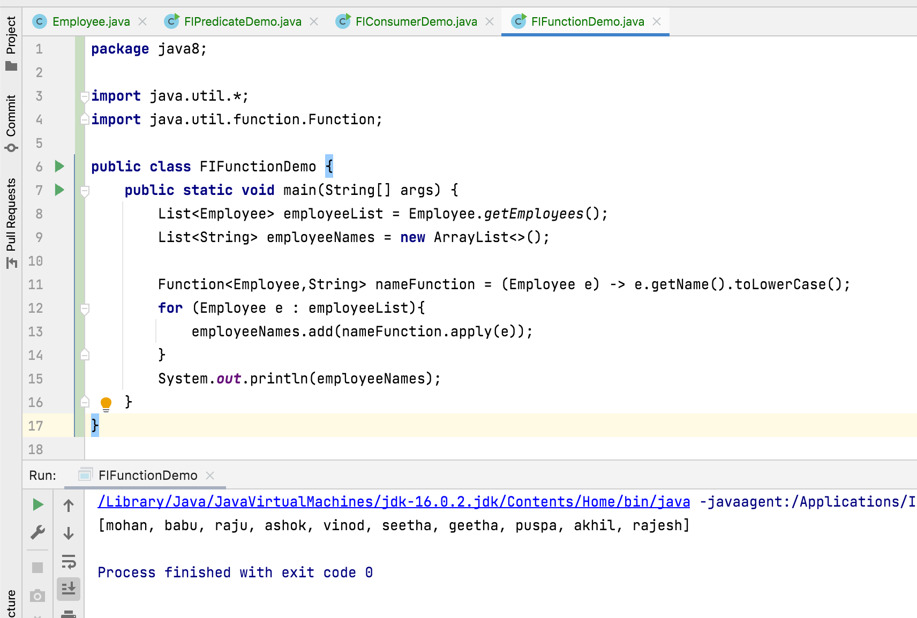

Slide 8
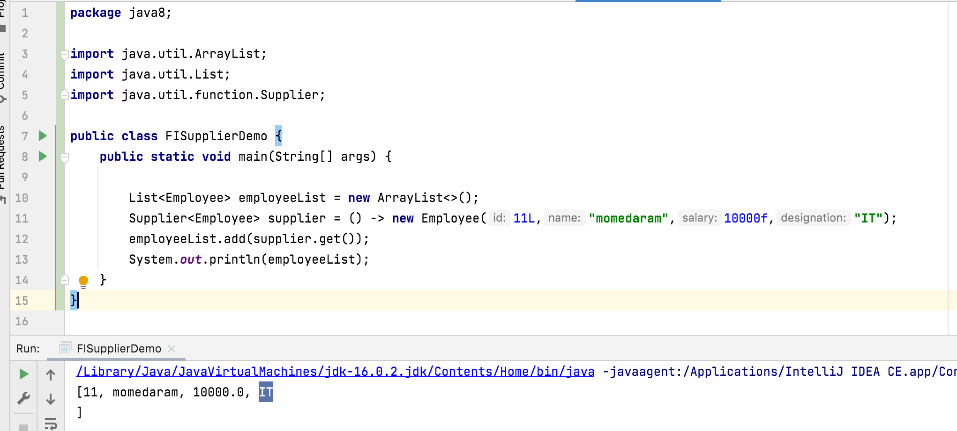
Supplier<T>:
Represents a supplier of results.
T get();
When To Use:
When we want to create a new object.

Slide 9
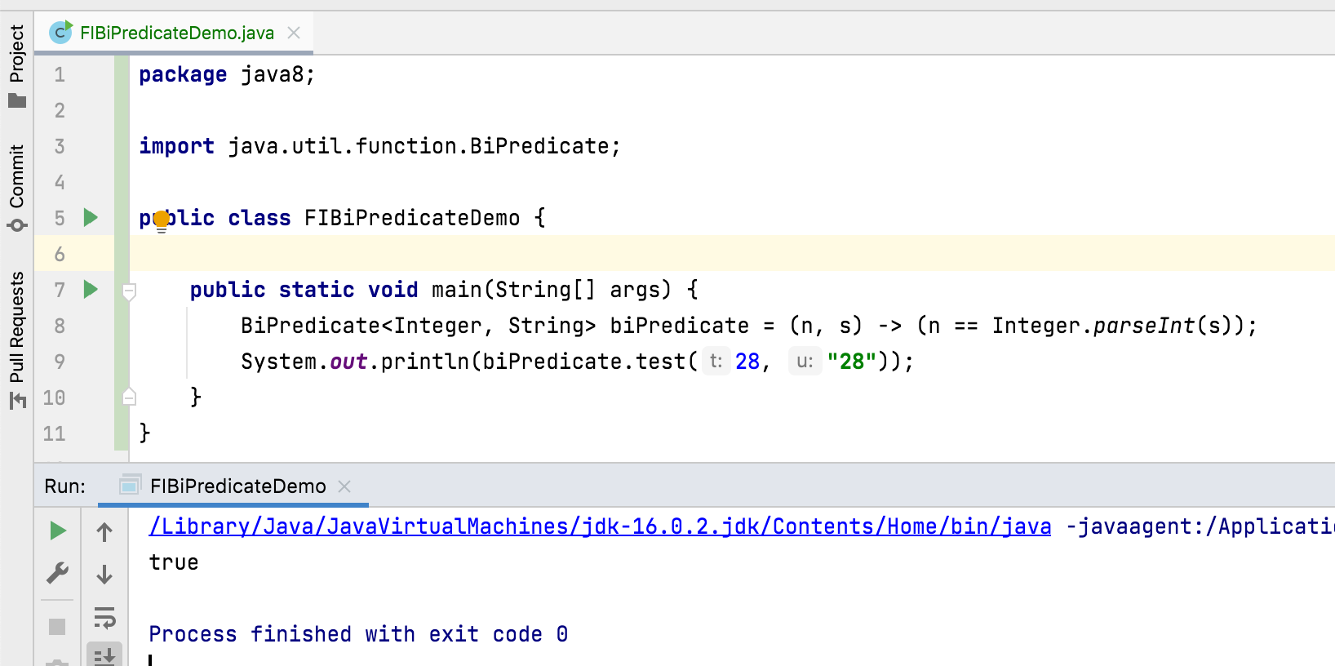
BiPredicate<T, U> :
Represents a predicate (boolean-valued function) of two arguments.
<T,U> –type of argument to the predicate
boolean test(T t, U u); Evaluates this predicate on the given arguments.

Slide 10
BiConsumer<T, U>:
Represents an operation that accepts two input arguments and returns no result.
void accept(T t, U u); Performs this operation on the given arguments.
BiFunction<T, U, R>:
Represents a function that accepts two arguments and produces a result
R apply(T t, U u); Applies this function to the given arguments.

Slide 11
Thank You !
momedaram

